Slide 1
CST499 Final Project
Braden Abbey
CST499: Capstone for Computer Software Technology
Amr Elchouemi
10/31/2022

Slide 2
SRS Document
The Course Enrollment system was to be built out following this SRS document. The SRS document is to outline the requirements used for the system build. The goal of the Course Enrollment system was to allow student to manage their class schedule in a fast and easy manner. The website will allow students to register for available classes and add them to their course schedule. They can also drop classes from semesters as they see fit.

Slide 3
SRS Document Continued
The course Enrollment system can be used on all devices and operating systems. The build has multiple requirements such as New users can create an account, Returning user can login, User can search for available courses, User can view course schedule, User can register for course, user can drop a course, User receives notification when course is available, and the user can log out. The Course Enrollment system will have multiple business rules in place such as users need to be able to view their schedule and register/drop courses as needed. Administrators of the system ill need to be able to troubleshoot issues such as resetting account's, and fixing errors.

Slide 4
Testing
Testing is one of the most important pieces to any software build. Testing helps us to reduce cost, time, and improves on maintainability and code quality. The Course Enrollment System will go through many various forms of testing such as Integration testing, component testing, system testing, and lastly acceptance testing. Integration testing is where we test modules, components, and units together (Awati, 2022, January 13). Component testing si where we test components independently without integrations. System testing is where we test the full system with all integration in tact. Acceptance testing is where we look at the system once it is done and make sure it has been built to requirements and gets ready to deliver to the customer (Acceptance testing. Tutorials Point, n.d.).

Slide 5
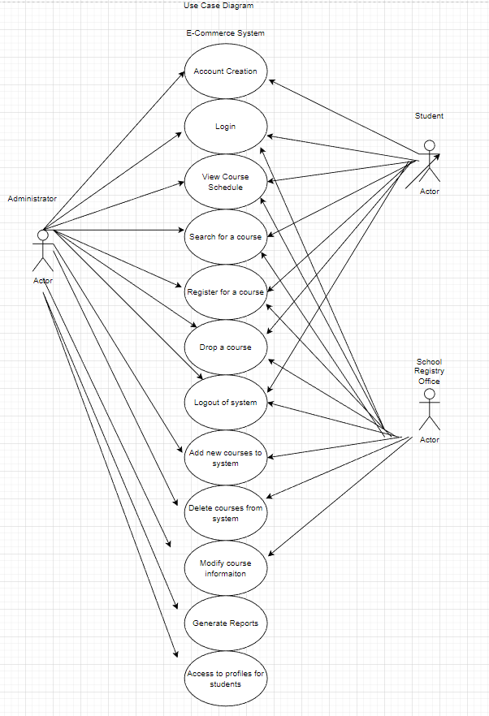
UML Model – Use case diagram

Slide 6
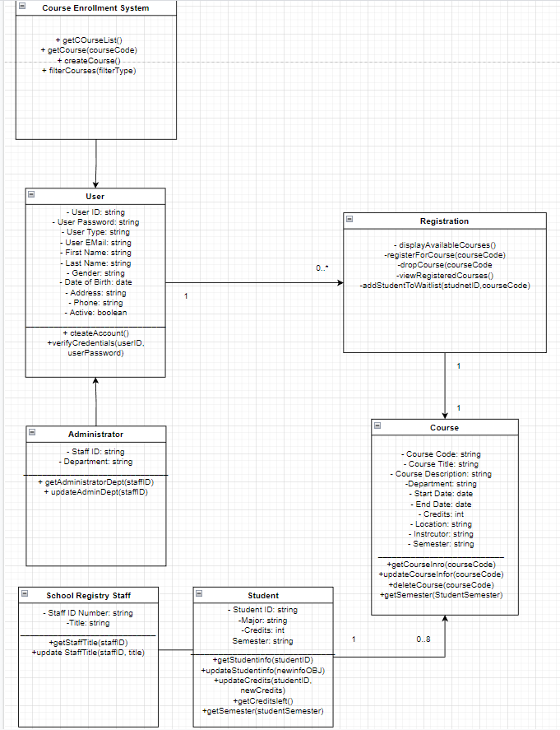
Uml model – class diagram

Slide 7
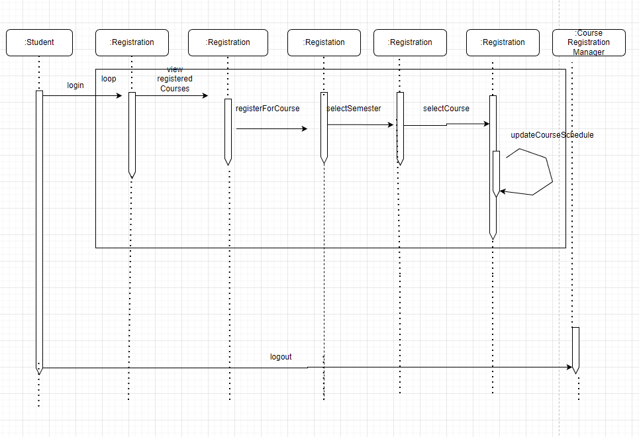
Uml model – sequence diagram

Slide 8
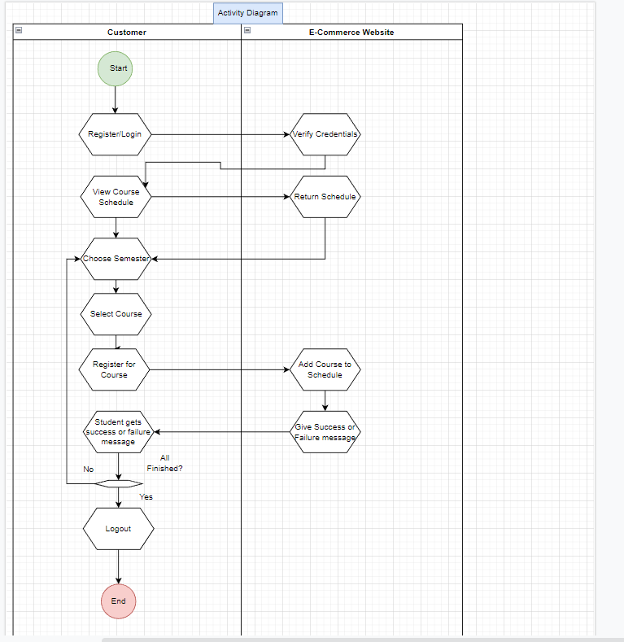
Uml model – Activity diagram

Slide 9
Landing Page, login, enrollment
I made the landing page with a blue background to be a little easier on the eyes. The top heading is the university and then under it I explain the system and about following instructions to get registered. I then made a list of the link available to the user and if they already have an account I provide a login option at the bottom. The login page Is very straight forward I used a style sheet to make a nice log in box that asks for email and password. Once input it refers to the SQL database and logs you in. The register screen brings you to a page that asks for all your basic information and then once done you hit register and it gives a prompt as to what you have put in and shoots the information over to the SQL database to be stored.

Slide 10
MYSQL Database
For the SQL databases I made a database called course_enrollment_system and then made various tables for the different information needed to be stored. I made a table for courses, enrollment, notifications, classes being offered, student login information, and a waitlist.

Slide 11
Class Registration
When it came to setting up the class registration I have 2 parts. One is looking for what classes are available and the other is registering for a class you may already know about. Once we are logged in we can go ahead and search for an available course. I made use of a navigation bar up top with various links to go back to the home page, register, search for courses, view courses, or log out. Once on this page from the drop down for semester we will choose spring, summer, or fall. Then for the year we will choose 2023 which is next year. After this we are provided with a course drop down to select our course. Once we make our selection and hit submit it gets added to our class schedule as long as there is room. If there isnt we get a notification we are on the wait list.

Slide 12
PHP Code Explanation
For my php code for this class I made use of links that redirect on click to the next page. For example view schedule will redirect on click to view schedule.php. Every link on the home page makes use a redirect function. On the search for available courses and course page I made use of functions.php. I functions.php I wrote out my code for the drop downs to reference my SQL database. I made use of while conditions to return data. Also in functions there are select statements used to pull in course information. The enrolled courses made use of left joins for the various tables return the correct courses.

